Slide 1
HARPURSVILLE CENTRAL SCHOOL DISTRICT
Public Hearing on Proposed Bus Vote
February 10, 2021

Slide 2
Long Term Fleet Rotation Plan
Proposed plan based on achieving and maintaining a 7 year fixed rotation on the district’s small & large bus fleet
Purchase Pattern used for Proposed Rotation:
Review current fleet size of 18 Type C’s (large buses), 2 Type A/B’s (small buses), and 2 Vans/ 1 Suburban (Two other vans out of service used for adult transportation only, Non-DOT)

Slide 3
Current Fleet Listing

Slide 4
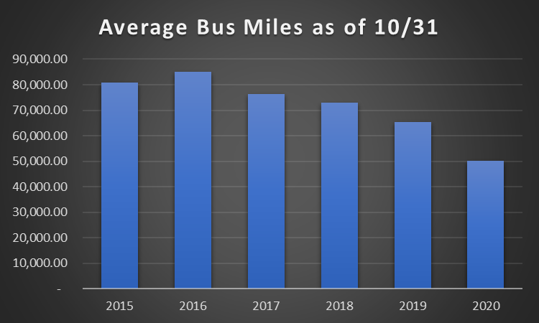
Average Yearly Mileage of Fleet as of 10/31/20

Slide 5
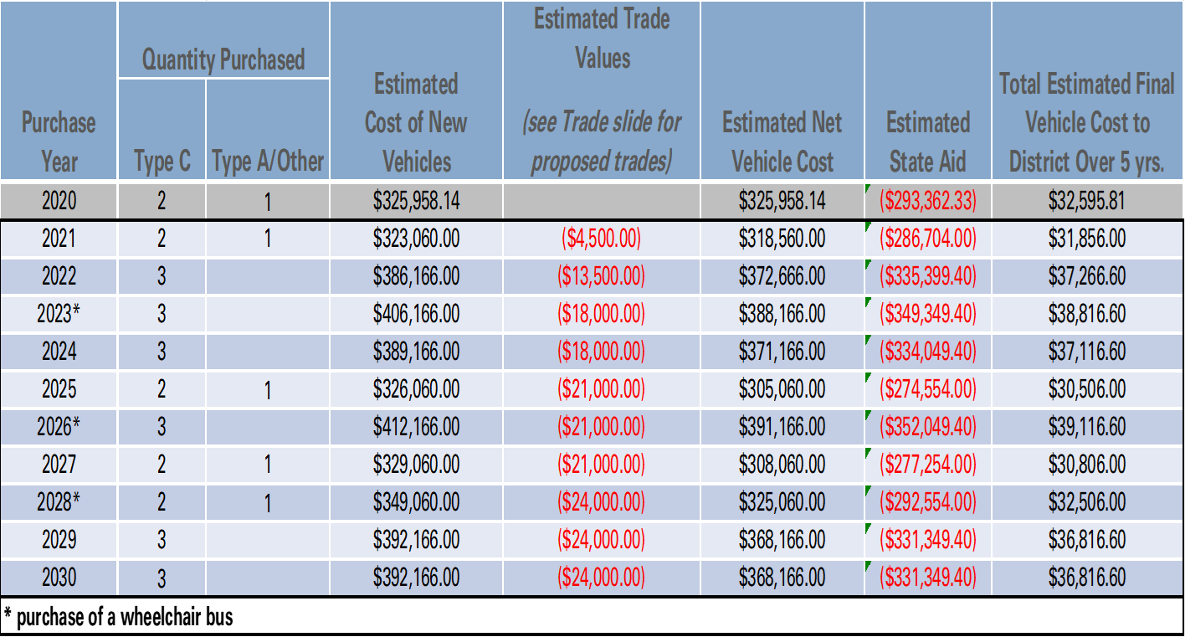
Long Term Fleet Rotation Plan

Slide 6
Bus Types and Cost
66 Passenger Diesel Bus ($128,722)
35 Passenger Diesel Bus ($65,616)

Slide 7
Time Table
February 16, 2021 - Special Meeting – Public Vote
March 2021 – Borrowing
Summer 2021 – Payment/Delivery of new buses

Slide 8
Thank You!

